Slide 1




Geostatistical data analysis 1
C. Edson Utazi
October 2026

Slide 2
Learning objectives:
By the end of this session, you will be able to:
Define and explain key terminology and concepts used in geostatistical data analysis
Explain and differentiate variograms, semivariograms, and covariance functions, and describe their roles in characterising spatial dependence in geostatistical models.
Estimate and visualise empirical variograms using real-world spatial data in R, and interpret the resulting plots to assess spatial dependence.

Slide 3
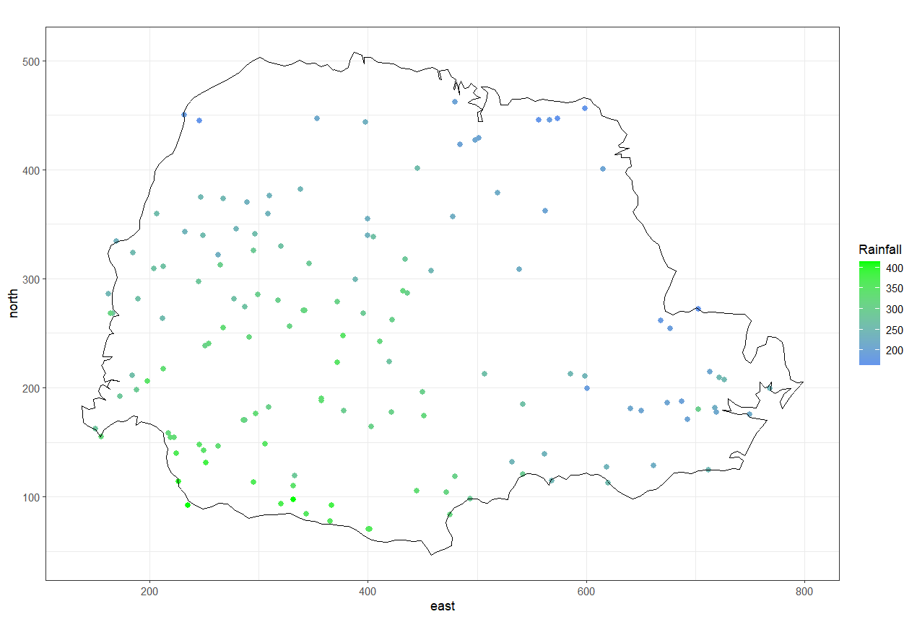
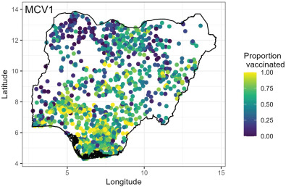
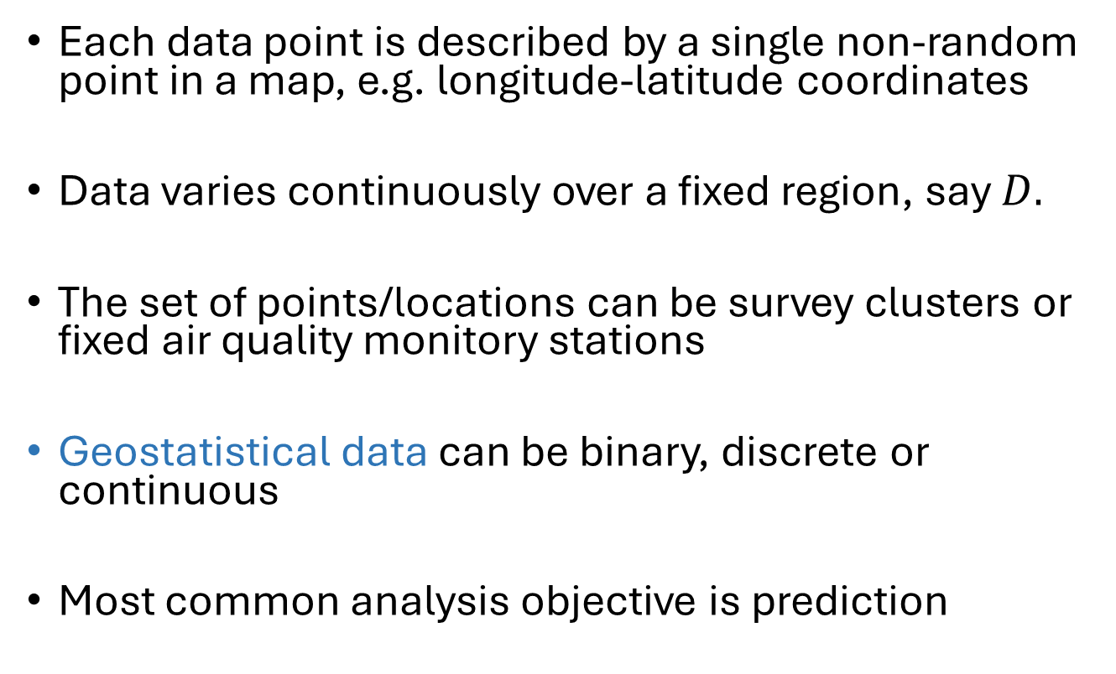
Recap – point-referenced data
Each data point is described by a single non-random point in a map, e.g. longitude-latitude coordinates
Data varies continuously over a fixed region, say $D.$
The set of points/locations can be survey clusters or fixed air quality monitory stations
Geostatistical data can be binary, discrete or continuous
Most common analysis objective is prediction
An attribute of the domain

Slide 4
Elements of geostatistical modelling
Stochastic processes or random fields
Stationarity
Variogram and covariogram
Isotropy
Matern covariance function

Slide 5
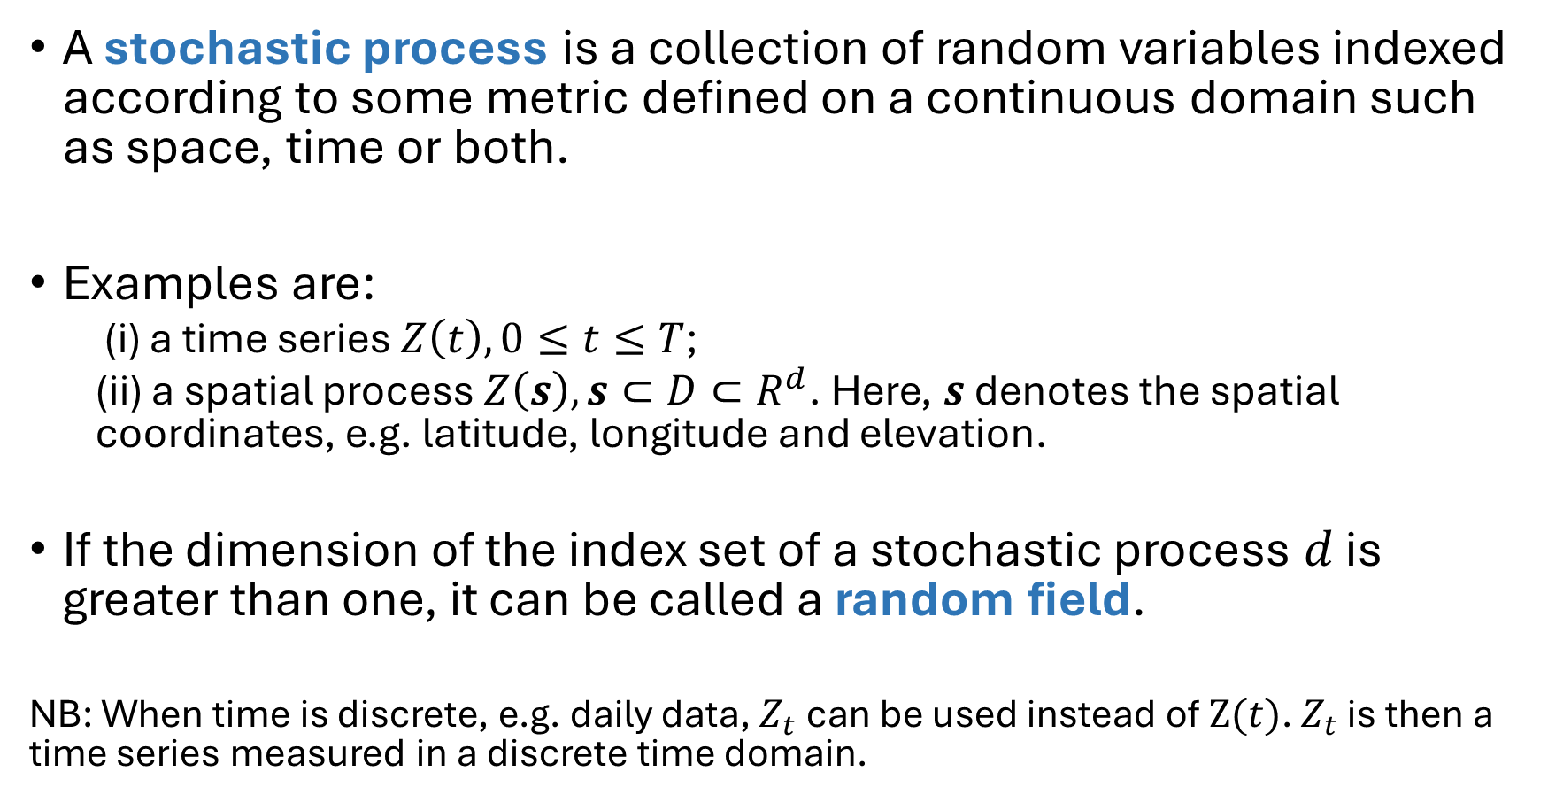
Stochastic processes
A stochastic process is a collection of random variables indexed according to some metric defined on a continuous domain such as space, time or both.
Examples are:
  (i) a time series $Z\left(t\right), 0≤t≤T$;
  (ii) a spatial process $Z\left(s\right), s⊂D⊂R^{d}$. Here, $s$ denotes the spatial coordinates, e.g. latitude, longitude and elevation.
If the dimension of the index set of a stochastic process $d$ is greater than one, it can be called a random field.
NB: When time is discrete, e.g. daily data, $Z_{t}$ can be used instead of $Z(t)$. $Z_{t}$ is then a time series measured in a discrete time domain.

Slide 6
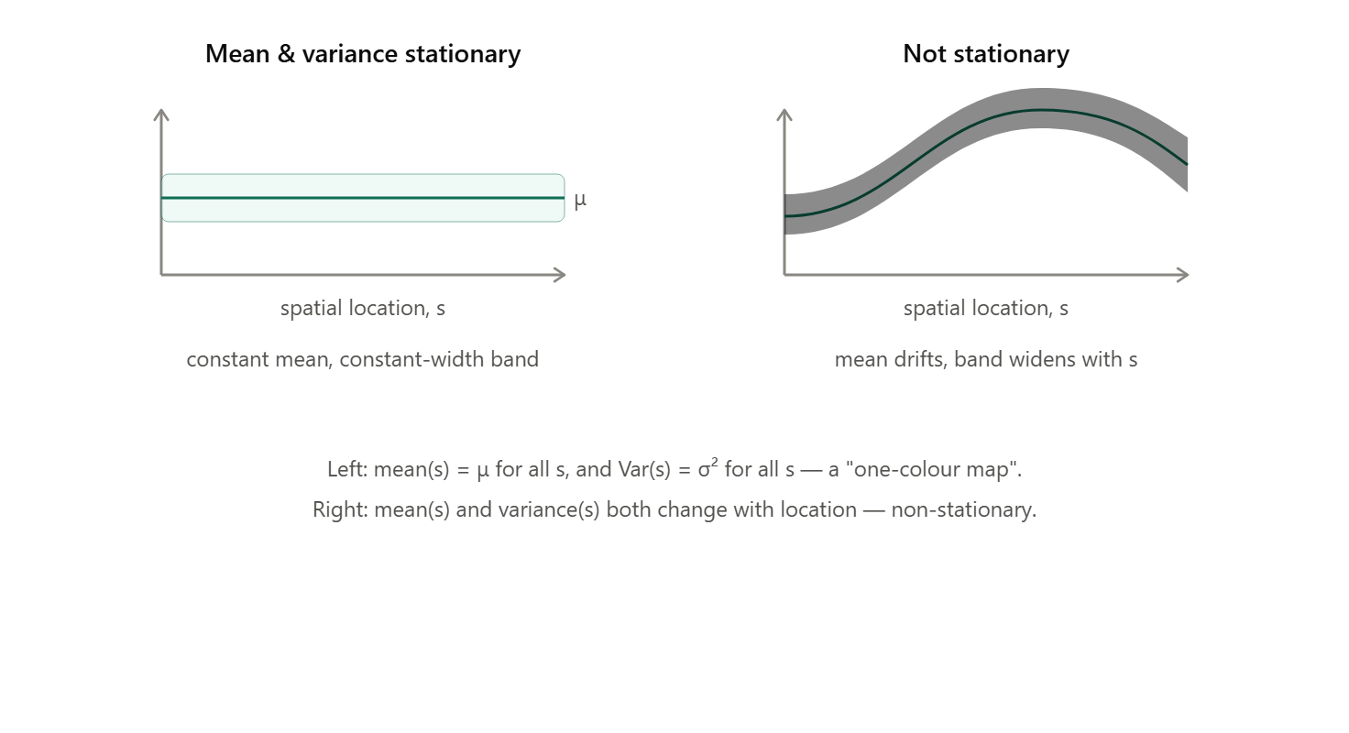
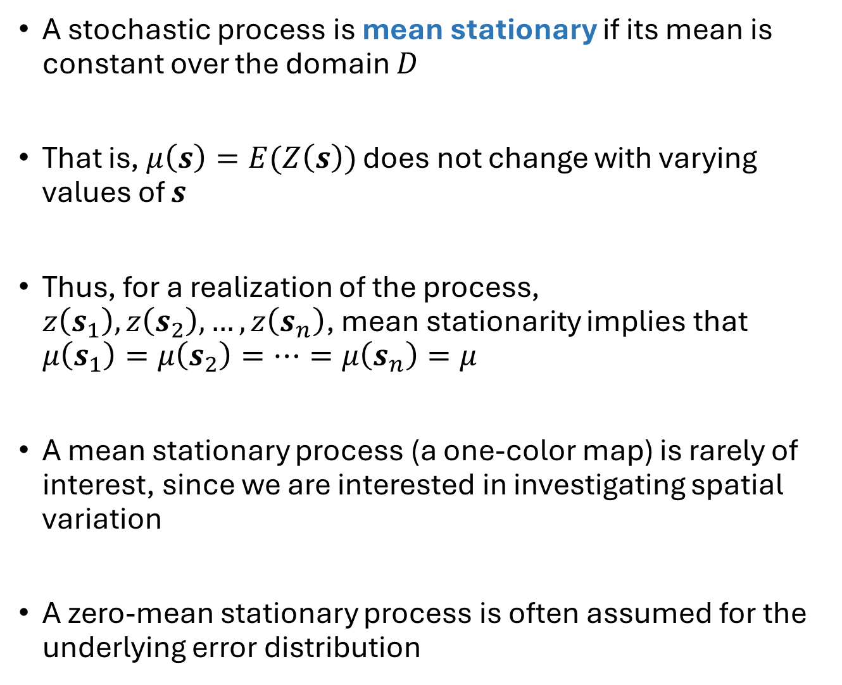
Stationarity
A stochastic process is mean stationary if its mean is constant over the domain $D$
That is, $μ\left(s\right)=E(Z\left(s\right))$ does not change with varying values of $s$
Thus, for a realization of the process, $z\left(s_{1}\right),z\left(s_{2}\right),…,z\left(s_{n}\right)$, mean stationarity implies that $μ\left(s_{1}\right)=μ\left(s_{2}\right)=…=μ\left(s_{n}\right)=μ$
A mean stationary process (a one-color map) is rarely of interest, since we are interested in investigating spatial variation
A zero-mean stationary process is often assumed for the underlying error distribution

Slide 7
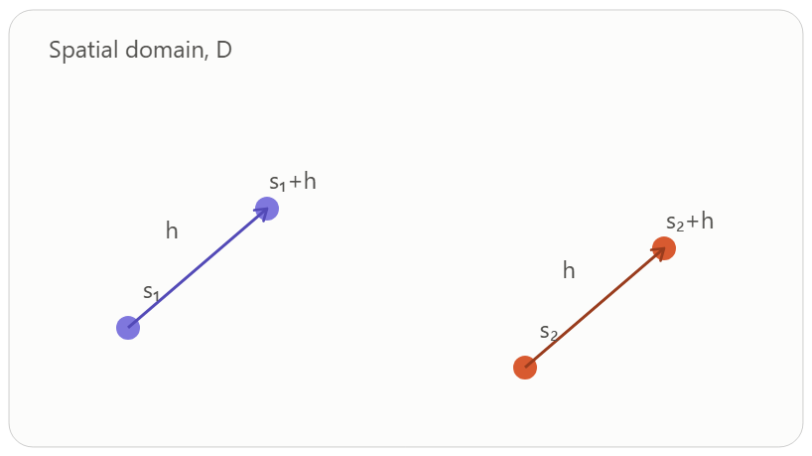
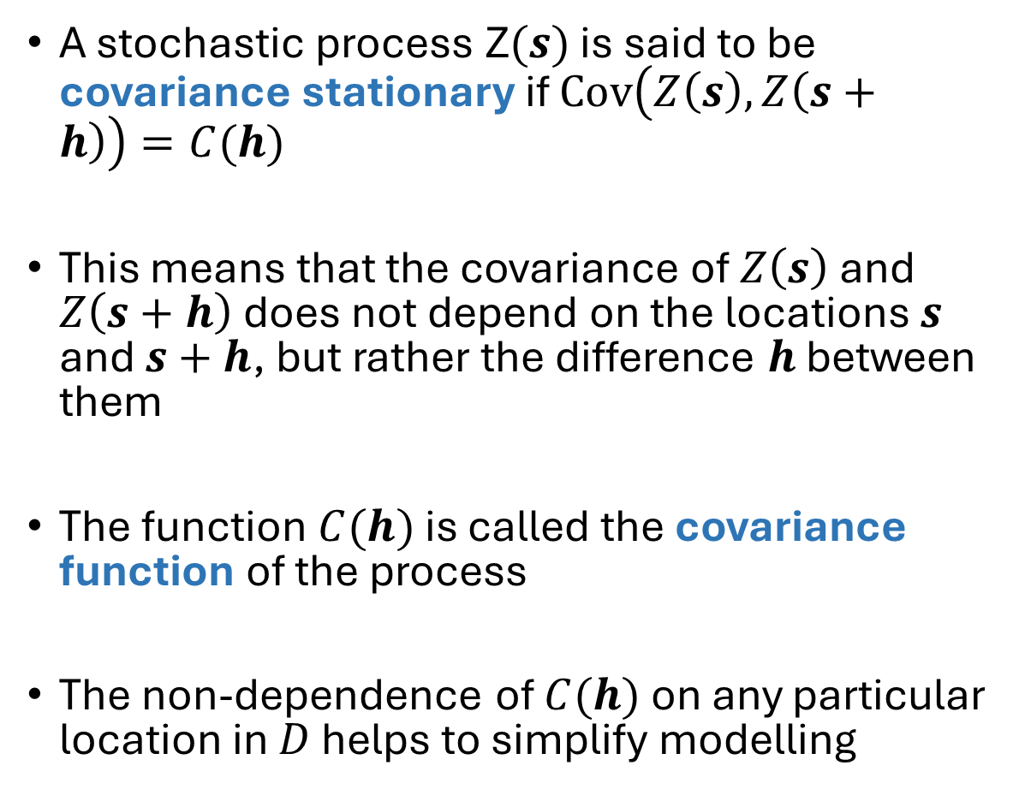
Stationarity
A stochastic process Z$(s)$ is said to be covariance stationary if $Cov\left(Z\left(s\right),Z\left(s+h\right)\right)=C(h)$
This means that the covariance of $Z\left(s\right)$ and $Z\left(s+h\right)$ does not depend on the locations $s$ and $s+h$, but rather the difference $h$ between them
The function $C(h)$ is called the covariance function of the process
The non-dependence of $C(h)$ on any particular location in $D$ helps to simplify modelling
Same separation vector h at two different locations → same covariance

Slide 8
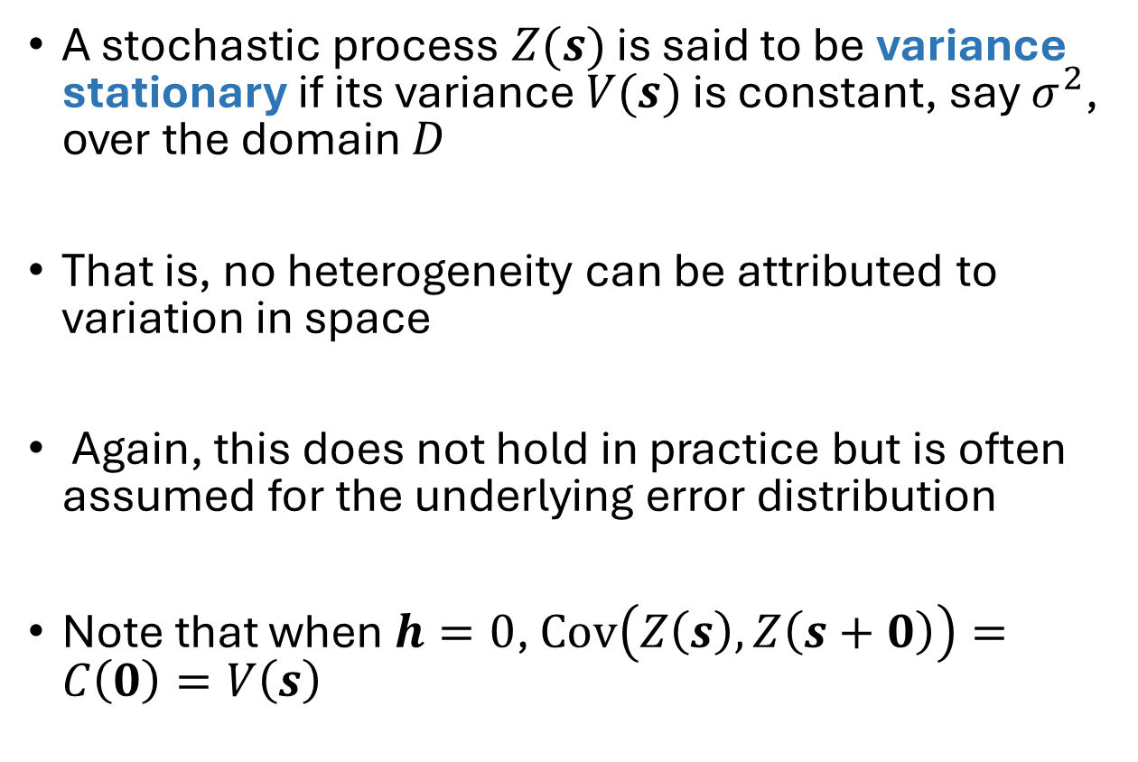
Stationarity
A stochastic process $Z(s)$ is said to be variance stationary if its variance $V(s)$ is constant, say $σ^{2}$, over the domain $D$
That is, no heterogeneity can be attributed to variation in space
Again, this does not hold in practice but is often assumed for the underlying error distribution
Note that when $h=0$, $Cov\left(Z\left(s\right),Z\left(s+0\right)\right)=C\left(0\right)=V\left(s\right)$

Slide 9
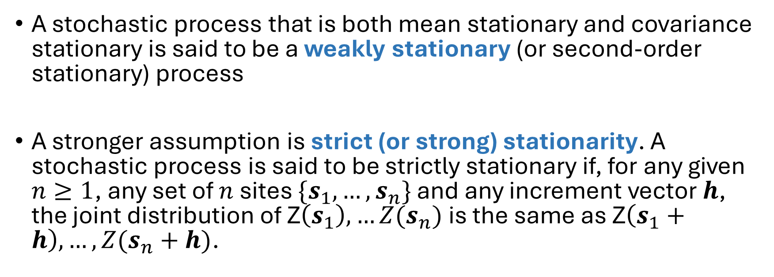
Stationarity
A stochastic process that is both mean stationary and covariance stationary is said to be a weakly stationary (or second-order stationary) process
A stronger assumption is strict (or strong) stationarity. A stochastic process is said to be strictly stationary if, for any given $n≥1$, any set of $n$ sites $\{s_{1},…,s_{n}\}$ and any increment vector $h$, the joint distribution of Z$\left(s_{1}\right),…Z(s_{n})$ is the same as Z$\left(s_{1}+h\right),…,Z(s_{n}+h)$.

Slide 10
Stationarity
For a strictly stationary process, a shift in location will not result in any change in the joint distribution of the random variables
A strictly stationary process is also a weakly or covariance stationary process, but the converse only holds for Gaussian processes (the entire joint distribution of a Gaussian process is defined by its mean vector and covariance matrix)
This is because we cannot claim that two random variables will have the same distribution if they have the same means and variances

Slide 11
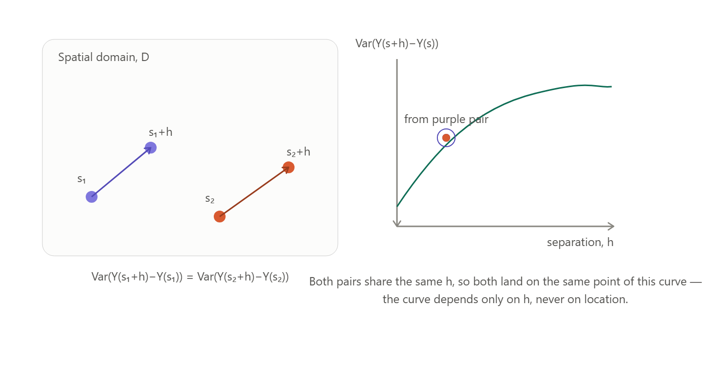
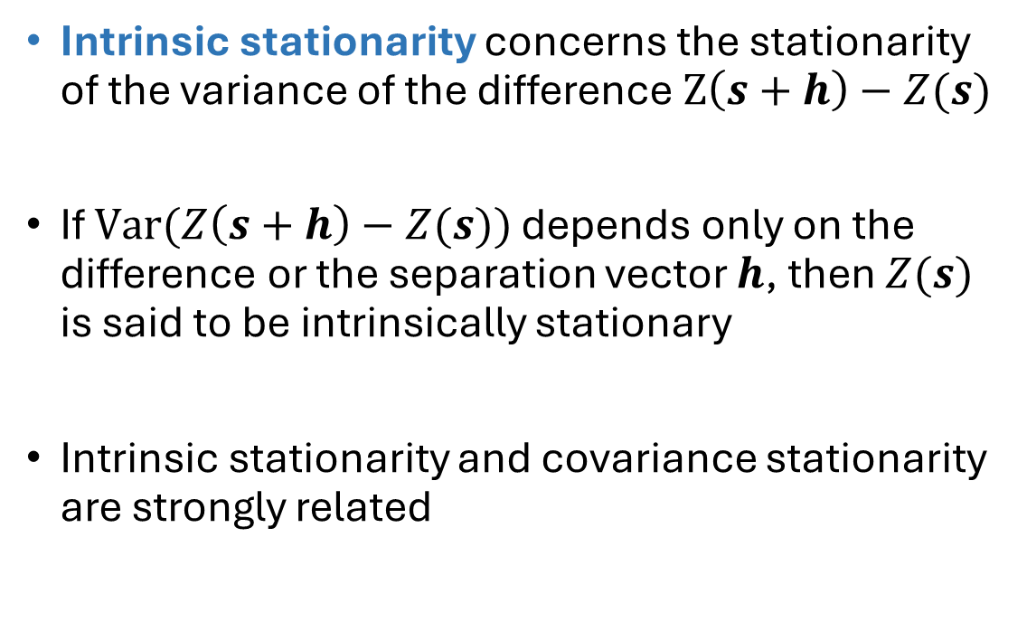

Intrinsic stationarity
Intrinsic stationarity concerns the stationarity of the variance of the difference $Z\left(s+h\right)−Z(s)$
If $Var(Z\left(s+h\right)−Z(s))$ depends only on the difference or the separation vector $h$, then $Z(s)$ is said to be intrinsically stationary
Intrinsic stationarity and covariance stationarity are strongly related
$Var(Z\left(s+h\right)−Z(s))$
Both pairs share the same h, so both land on the same point of this curve - the curve depends only on h, never on location.

Slide 12
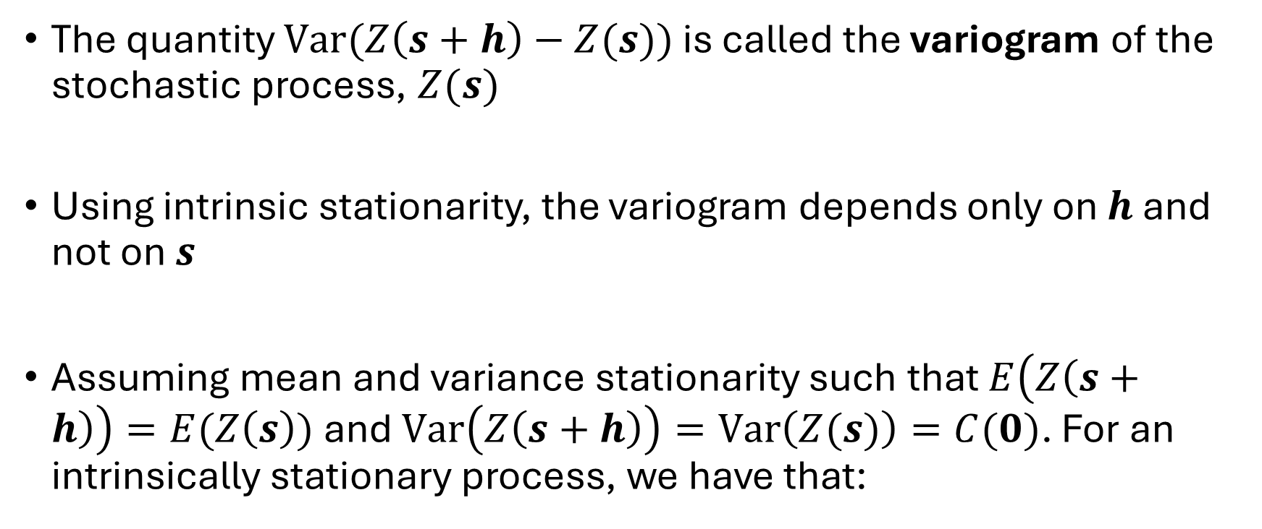
Variogram and covariogram/covariance
The quantity $Var(Z\left(s+h\right)−Z(s))$ is called the variogram of the stochastic process, $Z(s)$
Using intrinsic stationarity, the variogram depends only on $h$ and not on $s$
Assuming mean and variance stationarity such that $E\left(Z\left(s+h\right)\right)=E(Z\left(s\right))$ and $Var\left(Z\left(s+h\right)\right)=Var\left(Z(s)\right)=C(0)$. For an intrinsically stationary process, we have that:

Slide 13
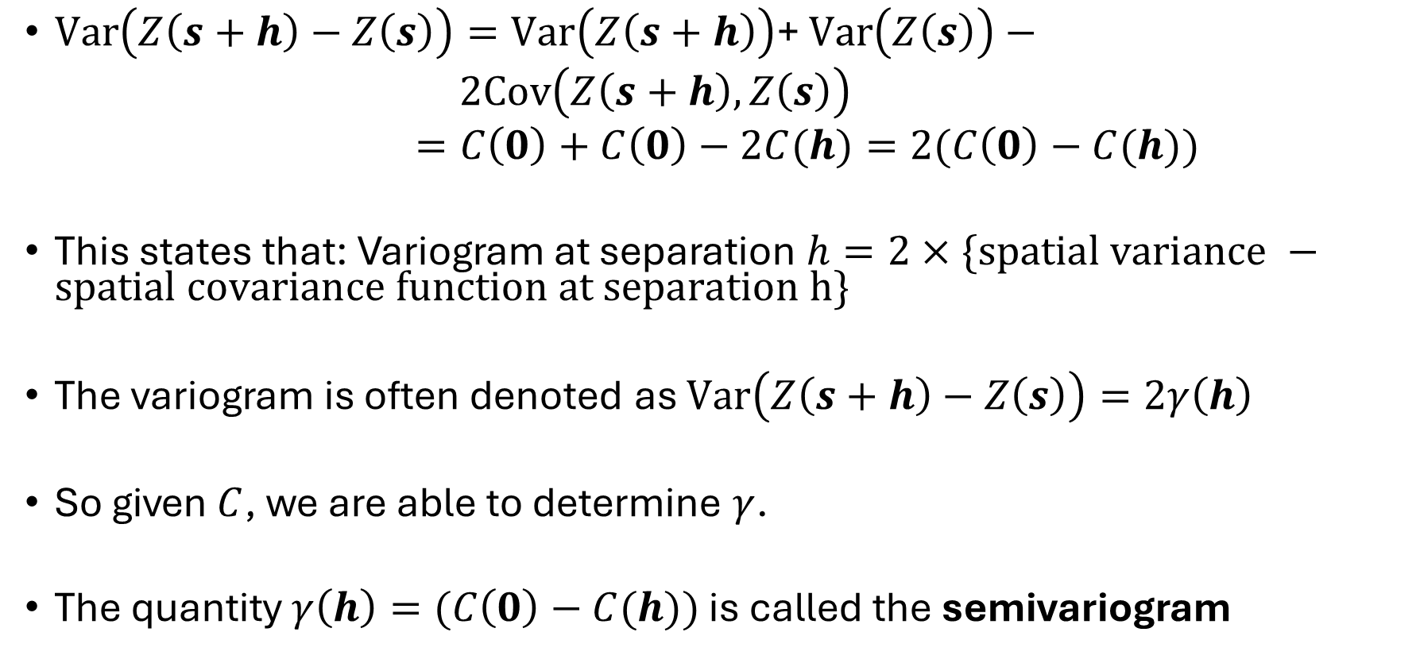
Variogram and covariogram/covariance
$Var\left(Z\left(s+h\right)−Z\left(s\right)\right)=Var\left(Z\left(s+h\right)\right)\text{+ }Var\left(Z\left(s\right)\right)−$
$2Cov\left(Z\left(s+h\right),Z\left(s\right)\right)$
$=C\left(0\right)+C\left(0\right)−2C(h)=2(C\left(0\right)−C(h))$
This states that: Variogram at separation $h=2×\{spatial variance −spatial covariance function at separation h\}$
The variogram is often denoted as $Var\left(Z\left(s+h\right)−Z\left(s\right)\right)=2γ\left(h\right)$
So given $C$, we are able to determine $γ$.
The quantity $γ\left(h\right)=(C\left(0\right)−C(h))$ is called the semivariogram

Slide 14
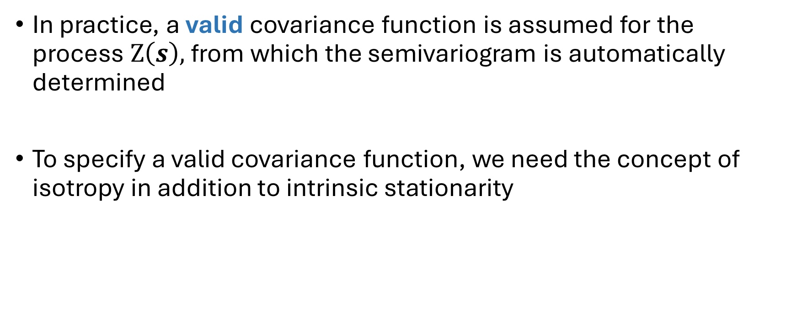
Variogram and covariogram/covariance
In practice, a valid covariance function is assumed for the process $Z\left(s\right),$ from which the semivariogram is automatically determined
To specify a valid covariance function, we need the concept of isotropy in addition to intrinsic stationarity
NB: Sometimes, the plot of C(h) against h is referred to as the covariogram

Slide 15
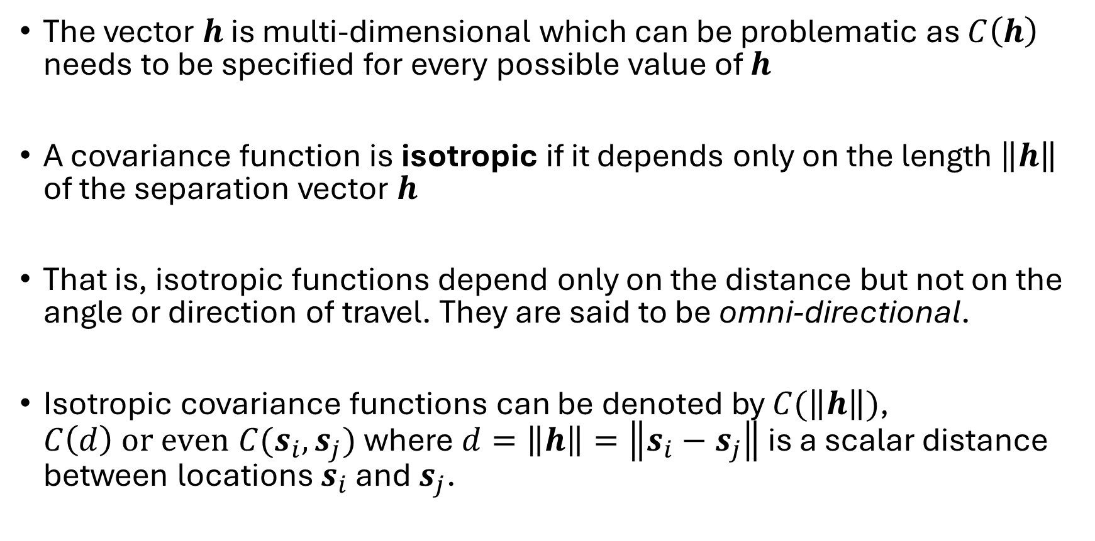
Isotropy
The vector $h$ is multi-dimensional which can be problematic as $C\left(h\right)$ needs to be specified for every possible value of $h$
A covariance function is isotropic if it depends only on the length $\left\|h\right\|$ of the separation vector $h$
That is, isotropic functions depend only on the distance but not on the angle or direction of travel. They are said to be omni-directional.
Isotropic covariance functions can be denoted by $C(\left\|h\right\|)$, $C\left(d\right) or even C(s_{i},s_{j})$ where $d=\left\|h\right\|=\left\|s_{i}−s_{j}\right\|$ is a scalar distance between locations $s_{i}$ and $s_{j}$.

Slide 16
Isotropy
A covariance function is called anisotropic if it is not isotropic
Anisotropy can be desirable if the phenomenon being modelled is direction-dependent. E.g. the spread of air pollution could depend on wind direction
However, for simplicity, isotropic covariance functions are used for the underlying true error process

Slide 17
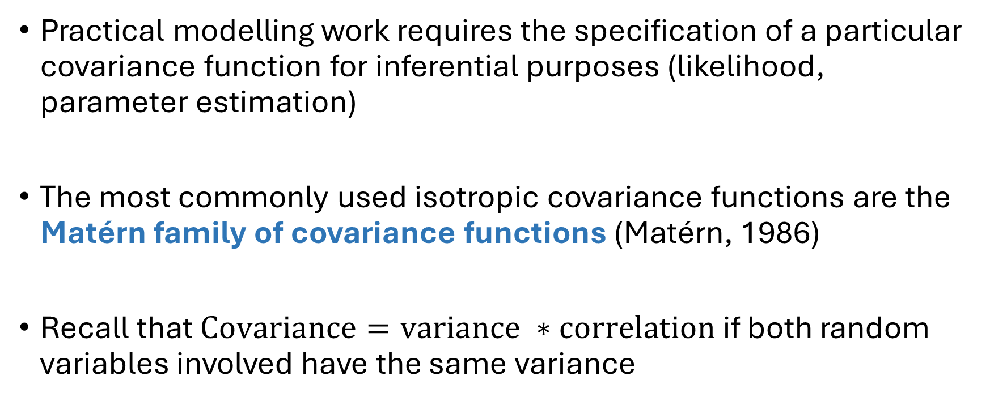
Matérn covariance function
Practical modelling work requires the specification of a particular covariance function for inferential purposes (likelihood, parameter estimation)
The most commonly used isotropic covariance functions are the Matérn family of covariance functions (Matérn, 1986)
Recall that $Covariance=variance ∗correlation$ if both random variables involved have the same variance

Slide 18
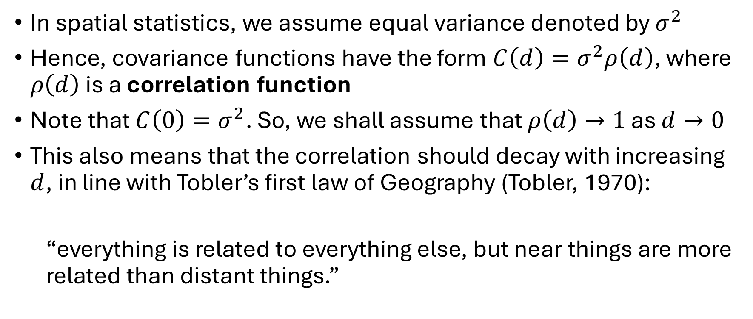
Matérn covariance function
In spatial statistics, we assume equal variance denoted by $σ^{2}$
Hence, covariance functions have the form $C\left(d\right)=σ^{2}ρ\left(d\right)$, where $ρ\left(d\right)$ is a correlation function
Note that $C\left(0\right)=σ^{2}$. So, we shall assume that $ρ\left(d\right)→1$ as $d→0$
This also means that the correlation should decay with increasing $d$, in line with Tobler’s first law of Geography (Tobler, 1970):
  “everything is related to everything else, but near things are more related than distant things.”

Slide 19
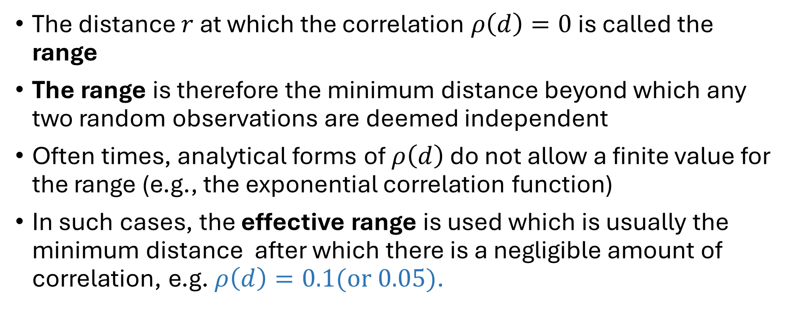
Matérn covariance function
The distance $r$ at which the correlation $ρ\left(d\right)=0$ is called the range
The range is therefore the minimum distance beyond which any two random observations are deemed independent
Often times, analytical forms of $ρ\left(d\right)$ do not allow a finite value for the range (e.g., the exponential correlation function)
In such cases, the effective range is used which is usually the minimum distance after which there is a negligible amount of correlation, e.g. $ρ\left(d\right)=0.1(or 0.05)$.

Slide 20
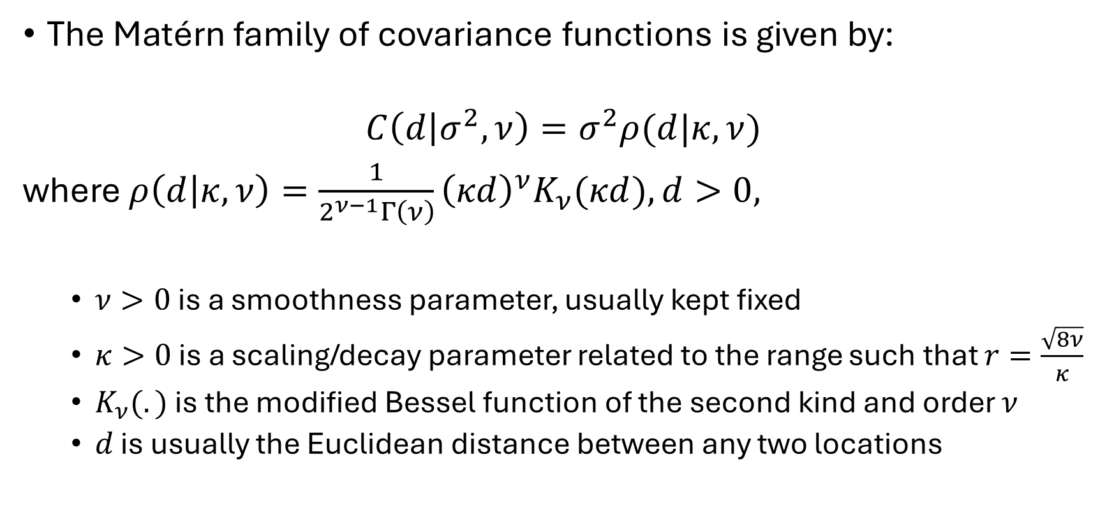
Matérn covariance function
The Matérn family of covariance functions is given by:
$$C\left(d | σ^{2},ν\right)=σ^{2}ρ(d|κ,ν)$$
where $ρ\left(d | κ,ν\right)=\frac{1}{2^{ν−1}Γ\left(ν\right)}{\left(κd\right)}^{ν}K_{ν}(κd), d>0,$
  $ν>0$ is a smoothness parameter, usually kept fixed
  $κ>0$ is a scaling/decay parameter related to the range such that $r=\frac{\sqrt{8ν}}{κ}$
  $K_{ν}(.)$ is the modified Bessel function of the second kind and order $ν$
  $d$ is usually the Euclidean distance between any two locations

Slide 21
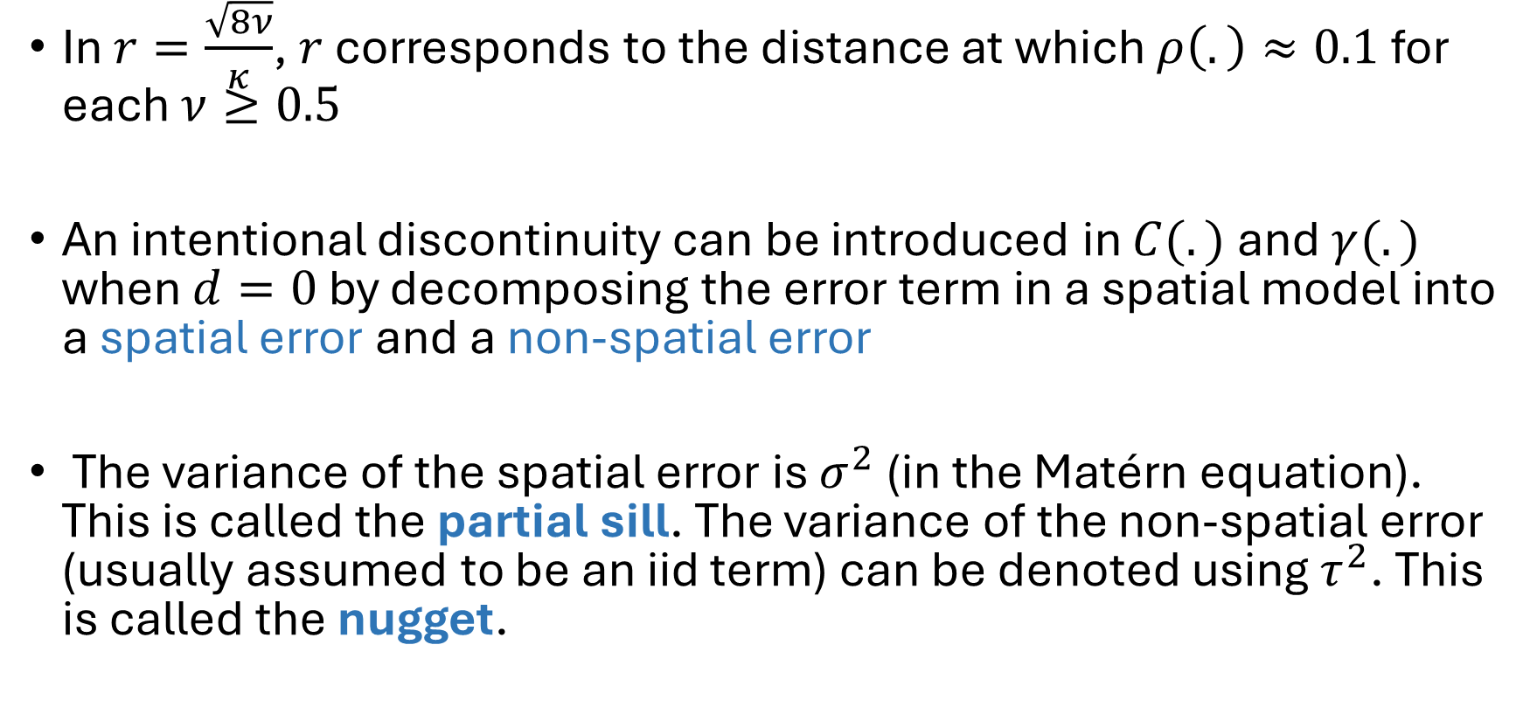
Matérn covariance function
In $r=\frac{\sqrt{8ν}}{κ}$, $r$ corresponds to the distance at which $ρ\left(.\right)≈0.1$ for each $ν≥0.5$
An intentional discontinuity can be introduced in $C(.)$ and $γ(.)$ when $d=0$ by decomposing the error term in a spatial model into a spatial error and a non-spatial error
The variance of the spatial error is $σ^{2}$ (in the Matérn equation). This is called the partial sill. The variance of the non-spatial error (usually assumed to be an iid term) can be denoted using $τ^{2}$. This is called the nugget.

Slide 22
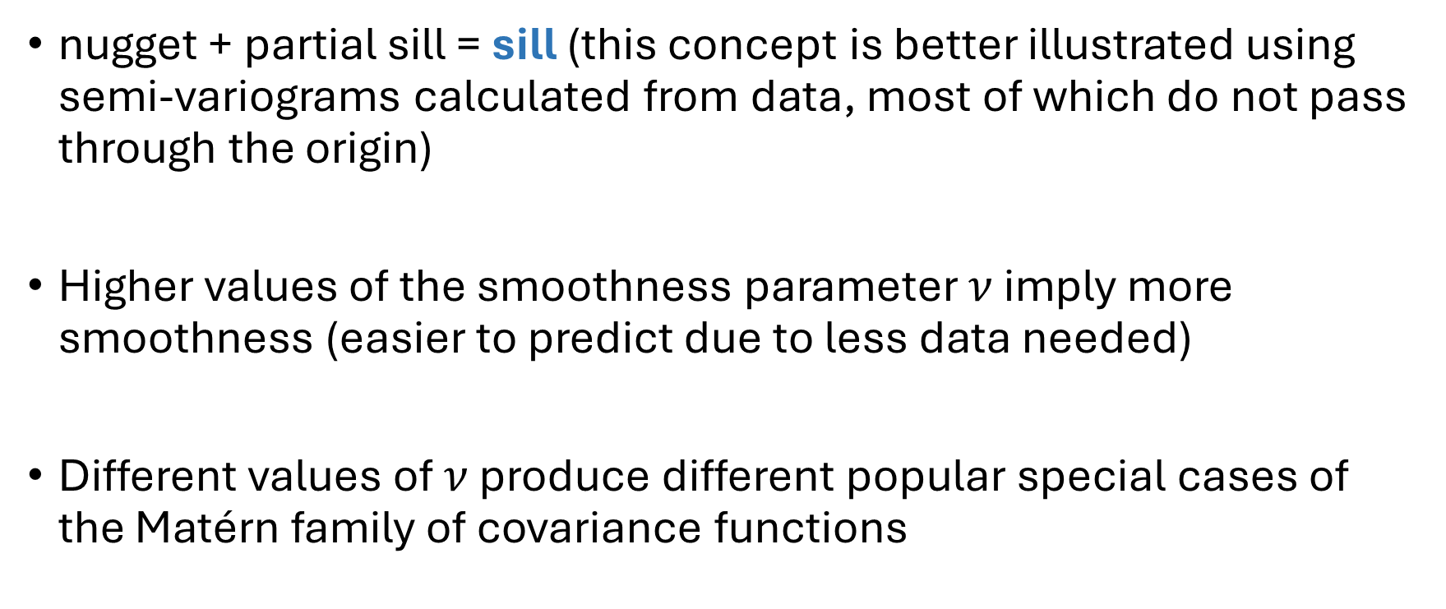
Matérn covariance function
nugget + partial sill = sill (this concept is better illustrated using semi-variograms calculated from data, most of which do not pass through the origin)
Higher values of the smoothness parameter $ν$ imply more smoothness (easier to predict due to less data needed)
Different values of $ν$ produce different popular special cases of the Matérn family of covariance functions

Slide 23
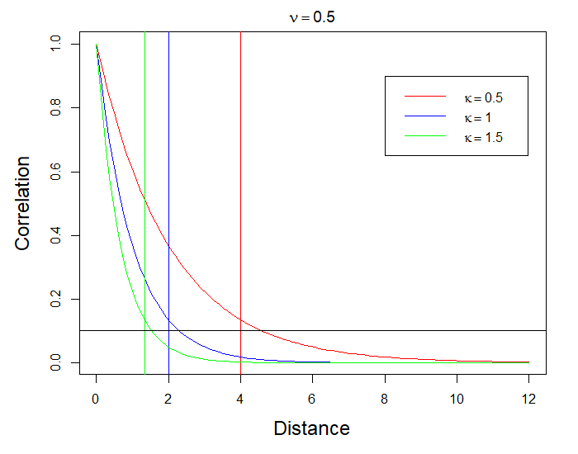
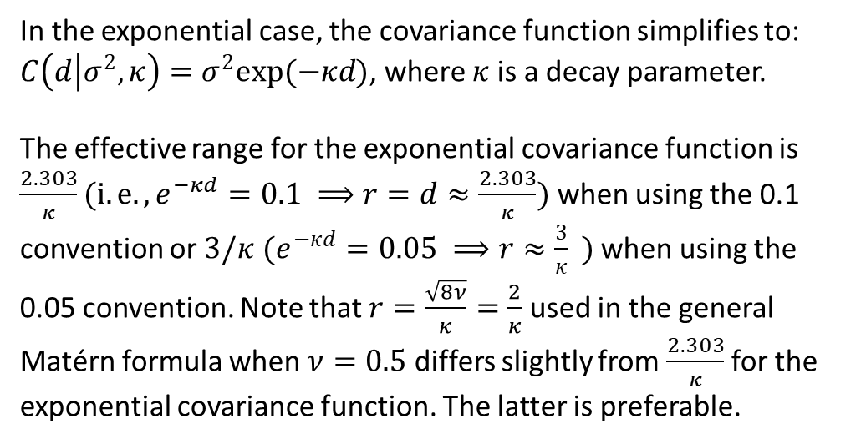
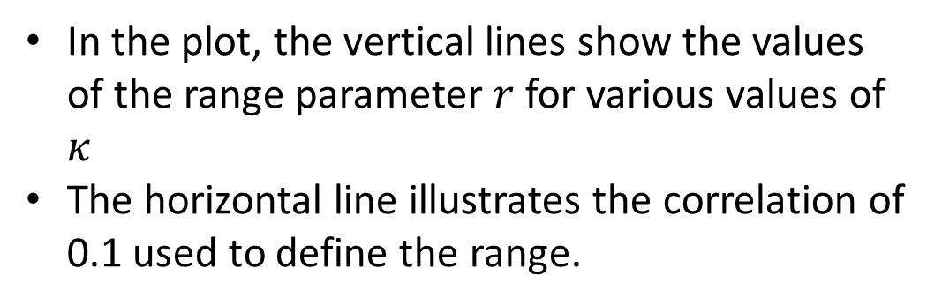
Matérn covariance function
When $ν=0.5$, we obtain the exponential covariance function
In the plot, the vertical lines show the values of the range parameter $r$ for various values of $κ$
The horizontal line illustrates the correlation of 0.1 used to define the range.
In the exponential case, the covariance function simplifies to: $C\left(d | σ^{2},κ\right)=σ^{2}exp⁡(−κd)$, where $κ$ is a decay parameter.
The effective range for the exponential covariance function is $\frac{2.303}{κ}(i.e., e^{−κd}=0.1 ⟹r=d≈\frac{2.303}{κ})$ when using the 0.1 convention or $3/κ$ $(e^{−κd}=0.05 ⟹r≈\frac{3}{κ} )$ when using the 0.05 convention. Note that $r=\frac{\sqrt{8ν}}{κ}=\frac{2}{κ}$ used in the general Matérn formula when $ν=0.5$ differs slightly from $\frac{2.303}{κ}$ for the exponential covariance function. The latter is preferable.

Slide 24
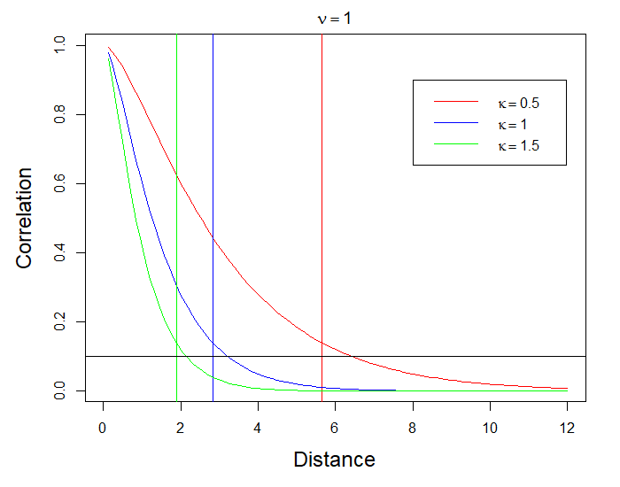
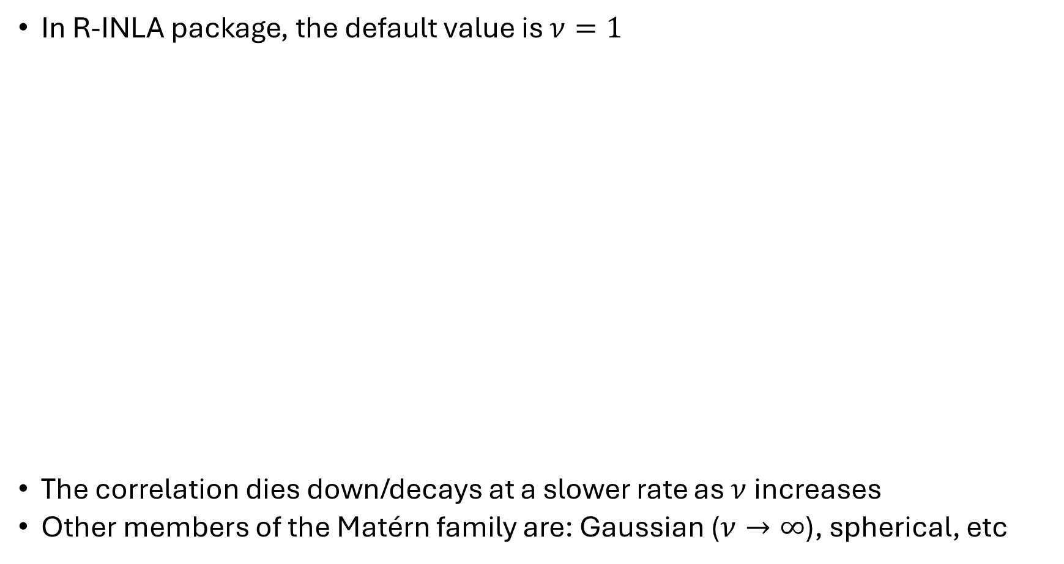
Matérn covariance function
In R-INLA package, the default value is $ν=1$
The correlation dies down/decays at a slower rate as $ν$ increases
Other members of the Matérn family are: Gaussian ($ν→∞$), spherical, etc

Slide 25
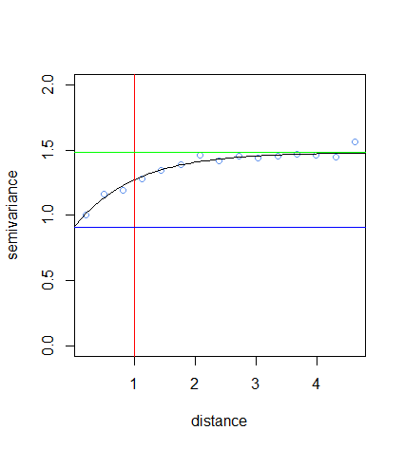
Empirical variogram model-fitting
An example variogram illustrating the sill (green line), nugget (blue line) and the range (red line)
partial sill
sill
nugget

Slide 26
Empirical variogram model-fitting
As we noted previously, the variogram model can be automatically determined once the form of the covariance/correlation function is known
In practice, however, the variogram is usually starting point of spatial analysis involving point-referenced data (variograms use pairwise differences and do not depend on the unknown mean of the process)
The (semi)variogram computed from observed data is called the empirical (semi)variogram

Slide 27
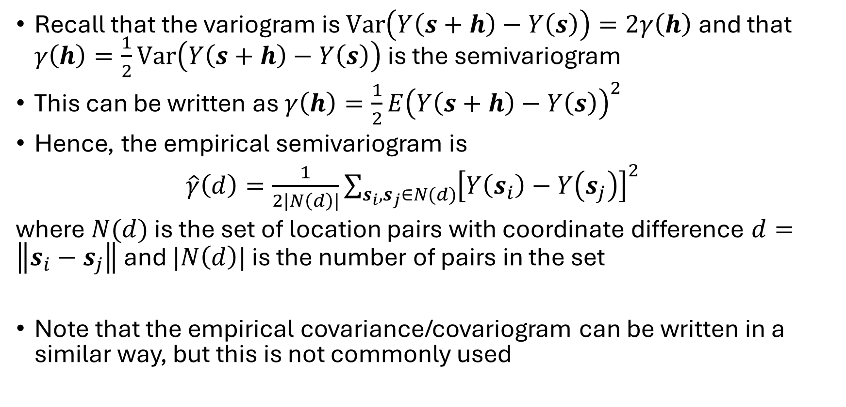
Empirical variogram model-fitting
Recall that the variogram is $Var\left(Y\left(s+h\right)−Y\left(s\right)\right)=2γ\left(h\right)$ and that $γ\left(h\right)=\frac{1}{2}Var\left(Y\left(s+h\right)−Y\left(s\right)\right)$ is the semivariogram
This can be written as $γ\left(h\right)=\frac{1}{2}E{\left(Y\left(s+h\right)−Y\left(s\right)\right)}^{2}$
Hence, the empirical semivariogram is
$\hat{γ}\left(d\right)=\frac{1}{2|N\left(d\right)|}\sum_{s_{i},s_{j}∈N(d)}{{\left[Y\left(s_{i}\right)−Y\left(s_{j}\right)\right]}^{2}}$
where $N(d)$ is the set of location pairs with coordinate difference $d=\left\|s_{i}−s_{j}\right\|$ and $|N\left(d\right)|$ is the number of pairs in the set
Note that the empirical covariance/covariogram can be written in a similar way, but this is not commonly used

Slide 28
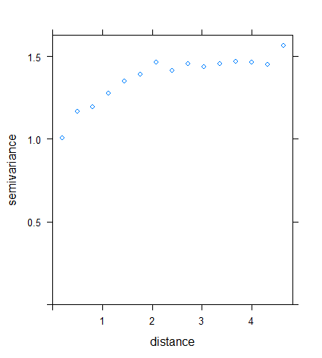
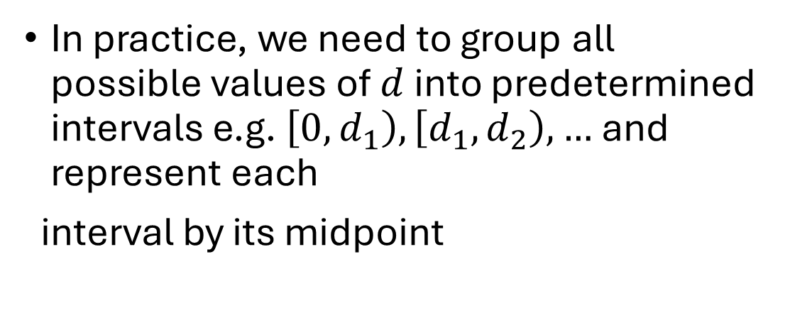
Empirical variogram model-fitting
Empirical semivariogram plot
In practice, we need to group all possible values of $d$ into predetermined intervals e.g. $\left[0, d_{1}\right),\left[d_{1},d_{2}\right),…$and represent each
interval by its midpoint

Slide 29
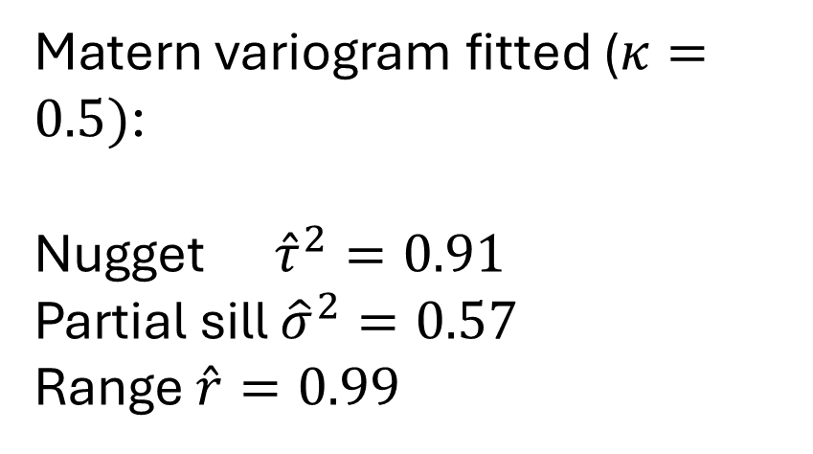
Empirical variogram model-fitting
Matern variogram fitted ($κ=0.5)$:
Nugget ${\hat{τ}}^{2}=0.91$
Partial sill ${\hat{σ}}^{2}=0.57$
Range $\hat{r}=0.99$

Slide 30
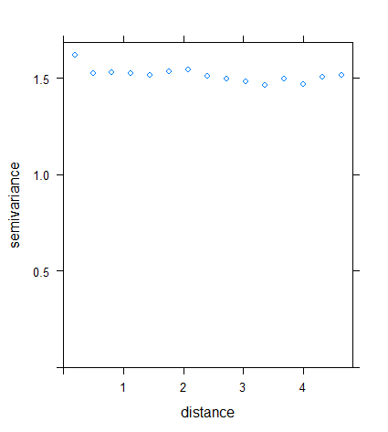
Empirical variogram model-fitting
The residuals were assigned at random to the locations to generate this plot. Observe that the variogram appears to be fluctuating around a fixed value and no longer increases with increasing distance.

Slide 31
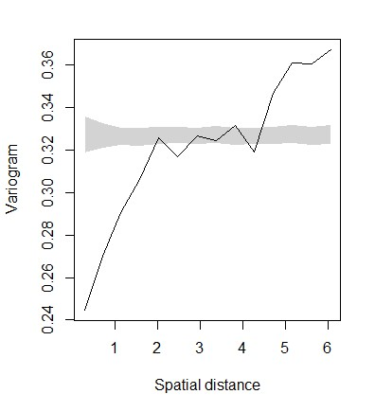
Empirical variogram model-fitting
In PrevMap package in R, the residuals are assigned to the locations multiple times to generate a variogram envelope (often shown as the 2.5% and 97.5% quantiles of the variogram estimates for each distance bin). This is known as the permutation test.
When the empirical variogram is not compatible with the variogram envelope, there is presence of spatial dependence/autocorrelation in the data.

Slide 32
Exercise 5: Variograms
Use variogram_script.R for this exercise
In this exercise, you will learn how to plot empirical variograms to test for residual spatial autocorrelation
The data used for this exercise were constructed to mimic cluster level Demographic and Health Survey (DHS) data for Nigeria. The data includes a binomial outcome showing assumed counts of numbers of children sampled from each cluster and corresponding assumed numbers of children who had been vaccinated. There are up to 1332 spatial locations in the data.

Slide 33
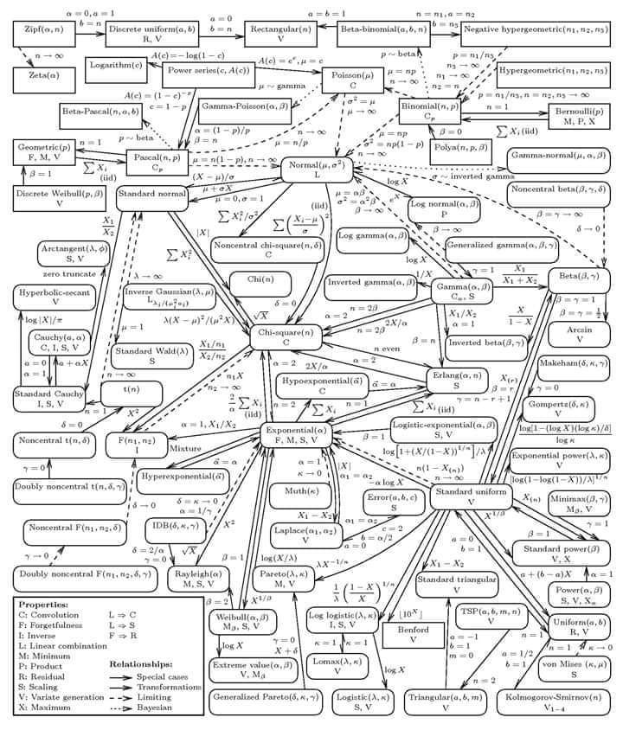

Stats can be crazy!

Slide 34
References
Matérn, B. (1986). Spatial variation (2nd ed.). Springer. https://doi.org/10.1007/978-1-4615-7892-5
Tobler, W. R. (1970). A computer movie simulating urban growth in the Detroit region. Economic Geography, 46(Suppl.), 234-240. https://doi.org/10.2307/143141

Slide 35
Further reading
Bayesian modelling of spatio-temporal data with R by Sujit K. Sahu. An accessible book for applied researchers. Covers relevant topics in spatial and spatiotemporal modelling.
Spatio-Temporal Statistics with R by Wikle et al. (2019). This is a very authoritative text book discussing the main statistics relevant for analyzing spatio-temporal data. It also discusses hierarchical modeling and model selection methods using INLA and other software packages.
Hierarchical Modeling and Analysis for Spatial Data by Banerjee et al. (2015). This book highlights hierarchical Bayesian modelling at an excellent theoretical and practical level. However, it again requires a very good background in mathematical statistics to fully appreciate the methodologies presented in the book.
Spatial and Spatio-temporal Bayesian Models with R - INLA by Blangiardo and Cameletti (2015). Practically-oriented, describes Bayesian methodology for spatial and spatio-temporal statistics.

